Slide 1
Online Learning for Noisy Polynomial
Name- Deepanshu Chauhan
Enrollment no. - 21566005
Under the guidance of:
Prof. Manu Kumar Gupta
Mehta Family School of Data Science and Artificial Intelligence
Indian Institute of Technology Roorkee

Slide 2
What is Bandit Algorithm?
Fig. Slot Machine (Source)
Unknown winning probability: $𝒫_{1}$, $𝒫_{2}$, $𝒫_{3}$,…, $𝒫_{k}$
Exploration vs Exploitation
Minimize regret

Slide 3
Contextual Bandits ?
Variant of multi-armed bandit algorithm
It considers context / state of environment before choosing any action.

Slide 4
Contextual Bandit for Personalized News Recommendation
When user arrive on website, a story is shown to the user among all the available stories, it is like pulling an arm
The algorithm will get a reward if user click on that story otherwise no reward will be awarded
Grouping the people based on some criteria
fig. News Recommendation (source: thegaudian.com)

Slide 5
UCB Algorithm
Source: udemy.com

Slide 6
UCB Algorithm

Slide 7
UCB Algorithm

Slide 8
UCB Algorithm

Slide 9
UCB Algorithm

Slide 10
UCB Algorithm

Slide 11
UCB Algorithm

Slide 12
UCB Algorithm

Slide 13
UCB Algorithm

Slide 14
UCB Algorithm

Slide 15
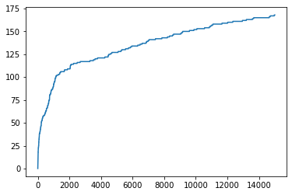
Neural Contextual Bandits
It leverages the representation power of deep neural networks and uses a neural network-based random feature mapping
Assumption of linear contextual bandit: the reward is assumed to be linear in the feature vector
Non-linear contextual bandit requires restrictive assumptions on the reward function
Neural network have been introduced to learn the underlying reward function in contextual bandit, thanks to their strong representation power
Reward
Time step
fig. Reward vs Time step

Slide 16
Polynomial Learning Using Neural Bandit Algorithm

Slide 17
Online Learning Model
Simulator
f(x) + $ε$
Simulator
f(x) + 𝜖
Update
$A_{t}$ = $A_{t−1}$ + $x_{t,a_{t}} x_{t,a_{t}}^{T}$
$$b_{t}= b_{t−1}+ r_{t} x_{t,a_{t}}$$
$$\hat{θ_{t}}= A_{t}^{−1}b_{t}$$
Update
𝐴_𝑡 = 𝐴_(𝑡−1) + 𝑥_(𝑡,𝑎_𝑡 ) 𝑥_(𝑡,𝑎_𝑡)^𝑇
𝑏_𝑡= 𝑏_(𝑡−1)+ 𝑟_𝑡 𝑥_(𝑡,𝑎_𝑡 )
(𝜃_𝑡 ) ̂= 𝐴_𝑡^(−1) 𝑏_𝑡
Optimizer
$$x_{t}=argma{x θ}_{t−1}^{−1}x_{t}+α |\left|x_{t}\right||_{A_{t−1}^{−1}}$$
Optimizer
𝑥_𝑡=𝑎𝑟𝑔𝑚𝑎〖𝑥 𝜃〗_(𝑡−1)^(−1) 𝑥_𝑡+𝛼 ||𝑥_𝑡 | |_(𝐴_(𝑡−1)^(−1) )
x
x, f(x)+$ε_{t}$, model degree

Slide 18
ILS and CILS Algorithm
ILS estimate the model curve by applying least squares to set of prior set of points and their values
Selects the point greedily with respect realized model for the next period.
CILS integrate forced-dispersion with ILS.
CILS with threshold parameter k suggests at time t point:
$$x_{t}=\left\{\begin{aligned}{\overline{x}}_{t−1}+\operatorname{sgn}\left(δ_{t}\right)kt^{−1/4}, if \left|δ_{t}\right|<kt^{−1/4} \\ &ILS, otherwise\end{aligned}\right.$$
where $δ_{t}$ = $x_{t−1}$- ${\overline{x}}_{t−1}$ , ${\overline{x}}_{t−1}$ = average of estimated points suggested over t-1 time period

Slide 19
Barycentric Spanner
Approximates the pairwise distances between set of points on a metric scale
Provides a way to efficiently split exploration-exploitation
Easily approximate the distances between the contexts
Identify similar or related contexts

Slide 20
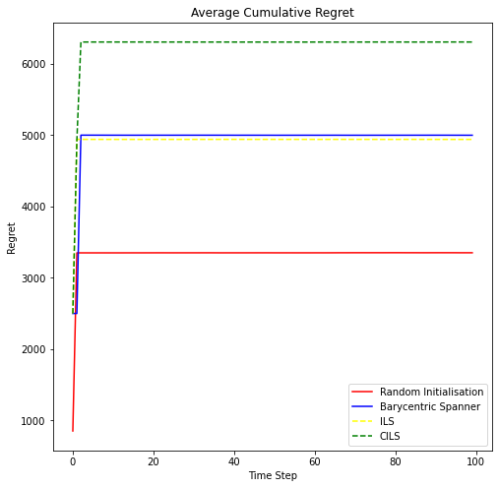
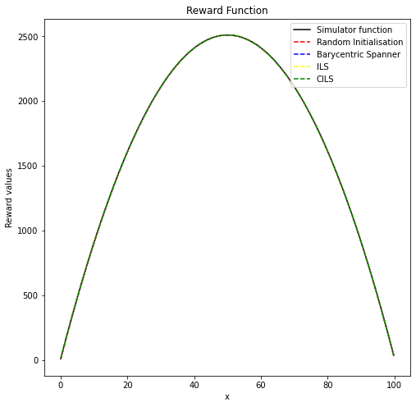
Results
Simulator function f(x) = 10 + 100x - $x^{2}$ + N(0,1)

Slide 21
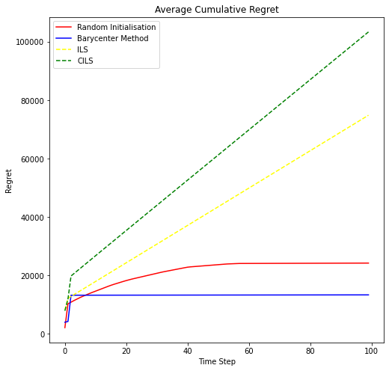
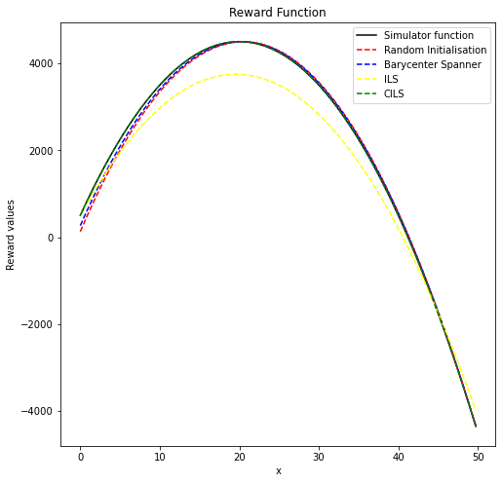
Continue…
f(x) = 500 + 400x - 10$x^{2}$ + N(0,1)

Slide 22
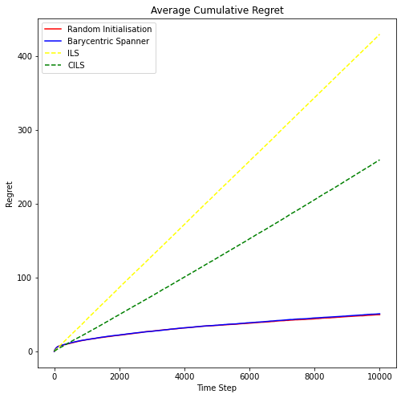
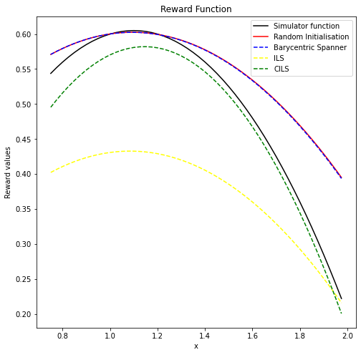
Continue…
f(x) = 1.1x – 0.5$x^{2}$ + N(0,0.01)

Slide 23
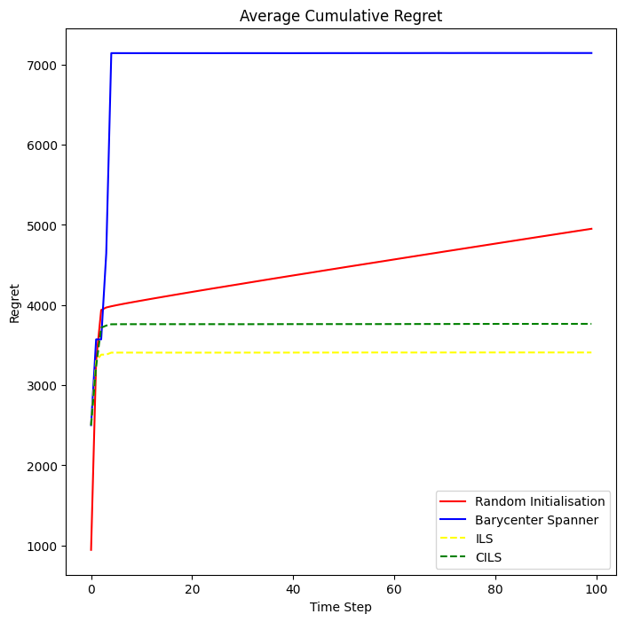
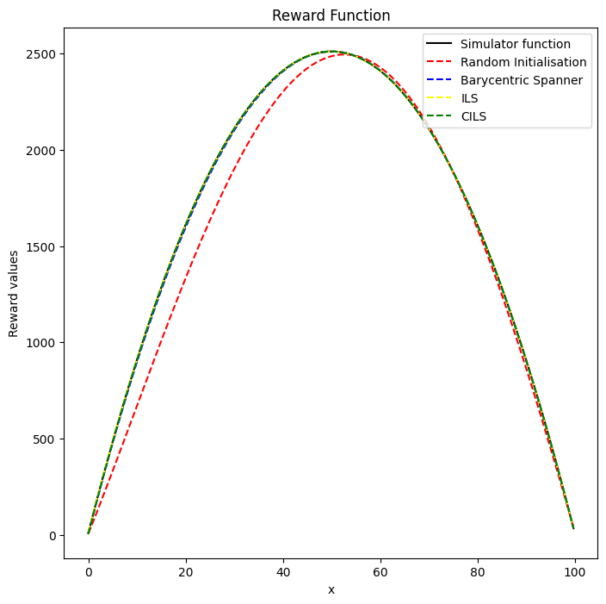
Continue…
f(x) = 10 + 100x - $x^{2}$ + N(0,1)

Slide 24
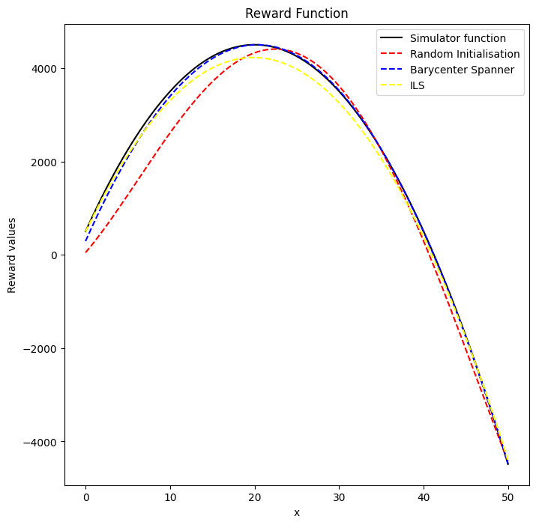
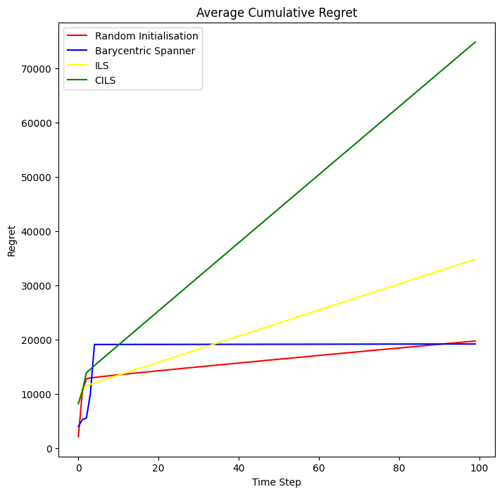
Continue…
f(x) = 500 + 400x - 10$x^{2}$ + N(0,1)

Slide 25
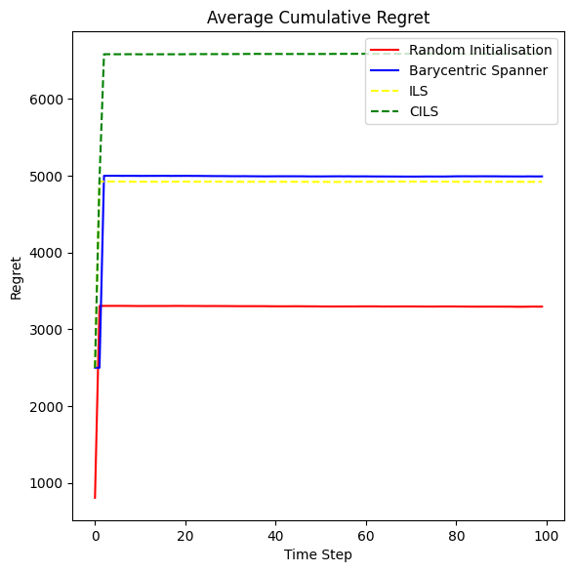
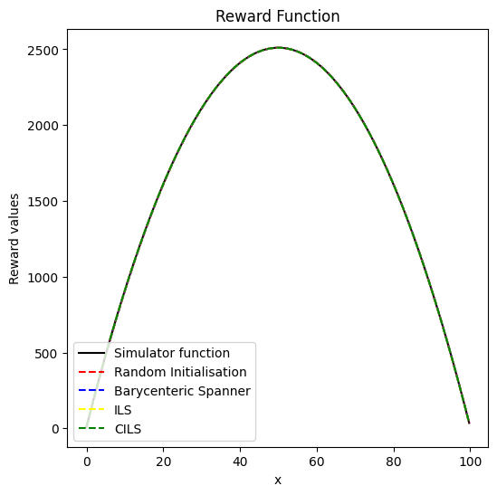
Continue…
f(x) = 10 +100x - $x^{2}$ + N(0,5)

Slide 26
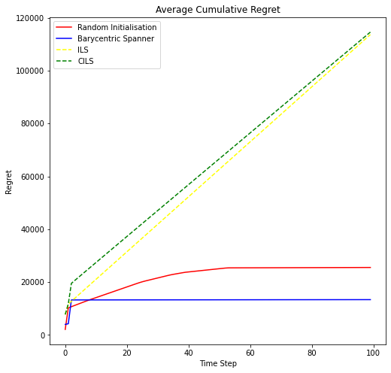
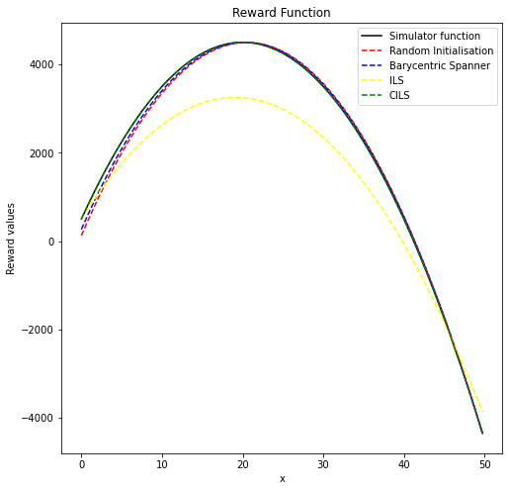
Continue…
f(x) = 500 + 400x - 10$x^{2}$ + N(0,5)

Slide 27
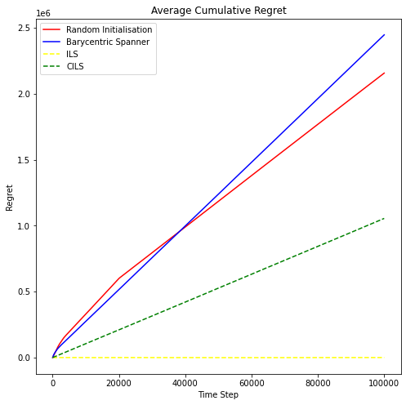
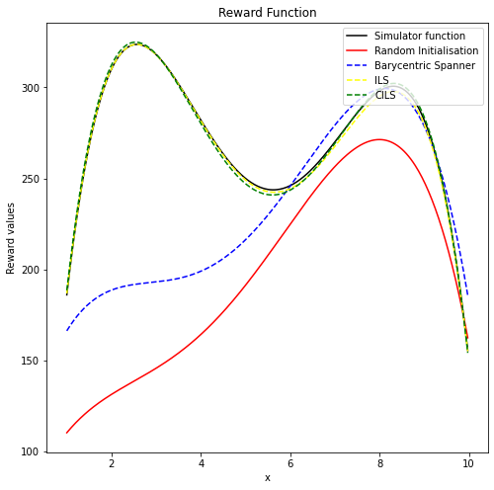
Continue…
f(x) = -150 + 480x - 165$x^{2}+22x^{3} − x^{4}$ + N(0,10)

Slide 28
Future Work
Use of Deep Neural Network to learn underlying function
Finally experimenting the algorithm with real world application

Slide 29
Refrences
Sutton, Richard S., and Andrew G. Barto. Reinforcement learning: An introduction. MIT press, 1998
Udemy.com
thegaurdian.com
Implementation of Polynomial Neural Bandit algorithm, https://github.com/dpc16/Polynomial-Neural-LinUCB.git

Slide 30
Thanks

